Slide 1

INSTITUTE UIE
DEPARTMENT ACADEMIC UNIT-1
Bachelor of Engineering (Computer Science & Engineering)
Subject Name Introduction Electrical & Electronics Engineering
Subject Code-23ECH-101
Prepared By
Dr. Shikha
Unit-1 Chapter-3
Introduction of Electrical & Electronics Circuit
Lecture No. 1.3.4
Boolean Algebra
DISCOVER . LEARN . EMPOWER

Slide 2
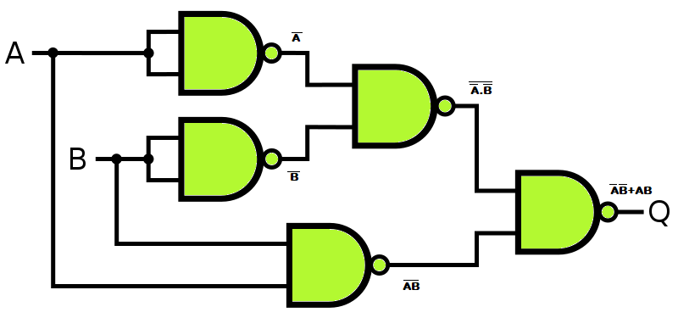
Lecture Objectives
S. No. | Objectives
1 | To make student aware about theorems of Boolean Algebra and different Boolean Theorems.
2 | To impart knowledge about application of Boolean algebra in digital circuits.
3 | To make and understand them reducing of complex digital logic into reduced form using Boolean Algebra.

Slide 3
Course Objectives
S. No. | Objectives
1 | Understand Electrical & Electronics Engineering Fundamentals
2 | To prepare students to perform the analysis and design of various Electrical & digital electronic circuits.

Slide 4
Course Outcomes
CO Number | Title | Level
CO1 | To identify the different types of electrical elements and the basic op-amp circuit elements and to illustrate the various types of motors, transducers. | Remember
CO2 | To understand basic principles of transformers, transducers, op-amps, DC and AC motors and to compare the different methods for analysing electrical and magnetic circuits. | Understand
CO3 | To derive the relationships between parameters in electric and magnetic circuits and motors and to determine specifications of op-amps. | Analyze
CO4 | To solve the basic problems related to electric circuits, magnetic circuits and motors and to assess the characteristics of different configurations of op-amps. | Evaluate
CO5 | To design the different applications of transducers, motors as well as the op-amps like adders, subtractor and comparators. | Create

Slide 5
Introduction To Boolean Algebra
Developed by English Mathematician George Boole
in between 1815 - 1864.
It is described as an algebra of logic or an algebra of two values i.e True or False.
The term logic means a statement having binary decisions i.e True/Yes or False/No

Slide 6
Applications of Boolean algebra
It is used to perform the logical operations in digital computer.
In digital computer True represent by ‘1’ (high volt) and False represent by ‘0’ (low volt)
Logical operations are performed by logical operators. The fundamental logical operators are:
AND (conjunction)
OR (disjunction)
NOT (negation/complement)

Slide 7
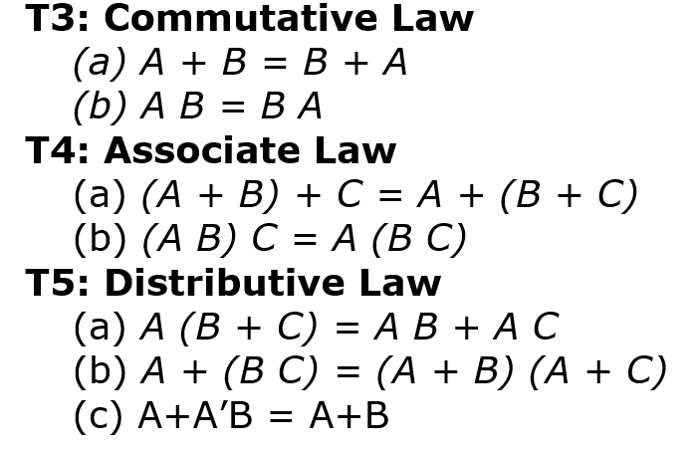
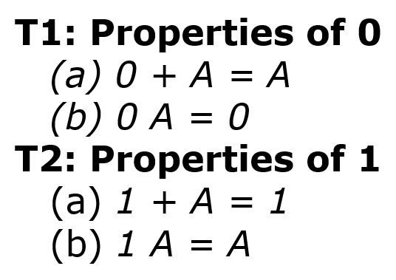
Basic Theorem of Boolean Algebra

Slide 8
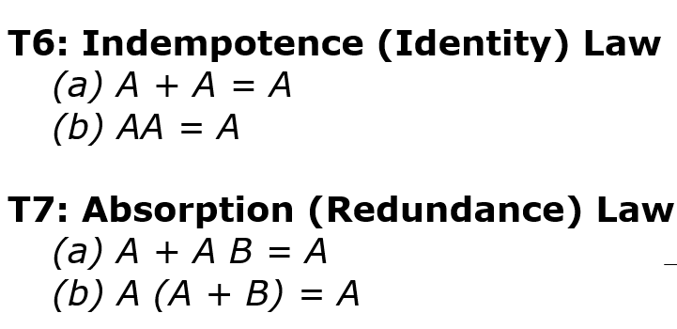
Basic Theorem of Boolean Algebra

Slide 9
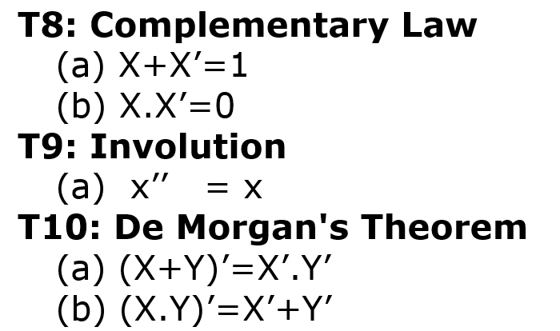
Basic Theorem of Boolean Algebra

Slide 10
Principal of Duality
In Boolean algebras the duality Principle can be is obtained by interchanging AND, and OR operators and replacing 0's by 1's and 1's by 0's. Compare the identities on the left side with the identities on the right.
Example
X.Y+Z' = (X'+Y').Z

Slide 11
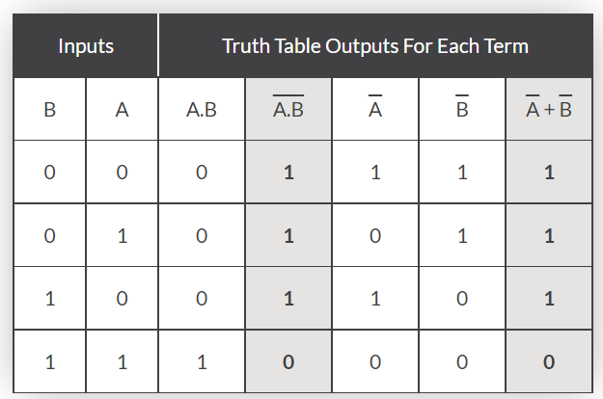
DeMorgan’s Theory: DeMorgan’s Theorems are basically two sets of rules or laws developed from the Boolean expressions for AND, OR and NOT using two input variables, A and B. These two rules or theorems allow the input variables to be negated and converted from one form of a Boolean function into an opposite form.
Verifying DeMorgan’s First Theorem using Truth Table
De Morgan’s First Theorem
DeMorgan’s First theorem proves that when two (or more) input variables are AND’ed and negated, they are equivalent to the OR of the complements of the individual variables. Thus the equivalent of the NAND function will be a negative-OR function, proving that A.B = A+B. We can show this operation using the following table.

Slide 12
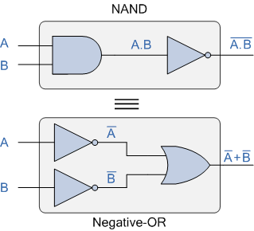
DeMorgan’s First Law Implementation using Logic Gates
The top logic gate arrangement of: A.B can be implemented using a standard NAND gate with inputs A and B. The lower logic gate arrangement first inverts the two inputs producing A and B. These then become the inputs to the OR gate. Therefore the output from the OR gate becomes: A+B
Then we can see here that a standard OR gate function with inverters (NOT gates) on each of its inputs is equivalent to a NAND gate function. So an individual NAND gate can be represented in this way as the equivalency of a NAND gate is a negative-OR.

Slide 13
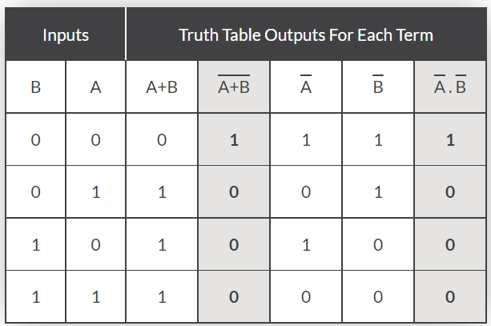
Verifying DeMorgan’s Second Theorem using Truth Table
DeMorgan’s Second Theorem
DeMorgan’s Second theorem proves that when two (or more) input variables are OR’ed and negated, they are equivalent to the AND of the complements of the individual variables. Thus the equivalent of the NOR function is a negative-AND function proving that A+B = A.B, and again we can show operation this using the following truth table.

Slide 14
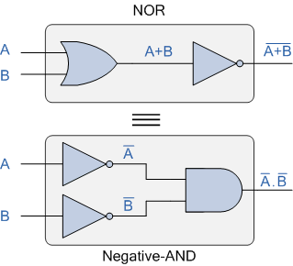
show that A+B = A.B using the following logic gates example.
DeMorgan’s Second aw Implementation using Logic Gates
The top logic gate arrangement of: A+B can be implemented using a standard NOR gate function using inputs A and B. The lower logic gate arrangement first inverts the two inputs, thus producing A and B. Thus then become the inputs to the AND gate. Therefore the output from the AND gate becomes: A.B
Then we can see that a standard AND gate function with inverters (NOT gates) on each of its inputs produces an equivalent output condition to a standard NOR gate function, and an individual NOR gate can be represented in this way as the equivalency of a NOR gate is a negative-AND.

Slide 15
Although we have used DeMorgan’s theorems with only two input variables A and B, they are equally valid for use with three, four or more input variable expressions, for example:
For a 3-variable input
A.B.C = A+B+C
and also
A+B+C = A.B.C
For a 4-variable input
A.B.C.D = A+B+C+D
and also
A+B+C+D = A.B.C.D
and so on.

Slide 16
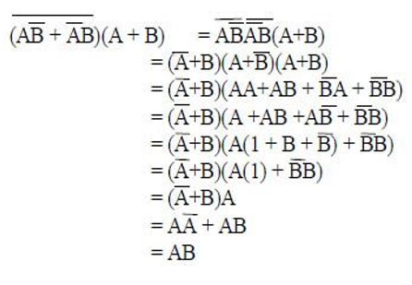
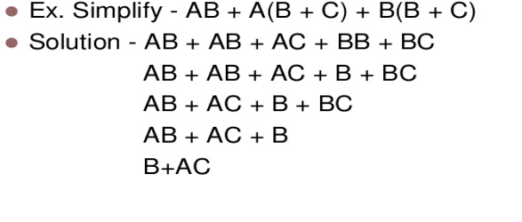
Examples Based on Boolean Algebra

Slide 17
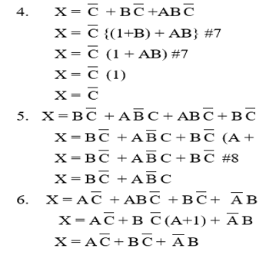
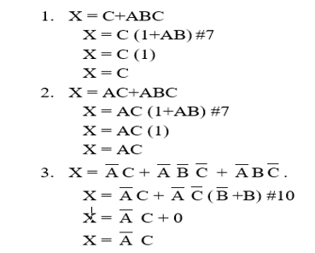
Examples Based on Boolean Algebra

Slide 18

REFERENCES
https://www.vivaxsolutions.com/physics/allogicgates.aspx
https://www.androiderode.com/ttl-not-gate/
Mano,Morris, Digital Design, Prentice Hall of India.
Fletcher, An Engg. Approach to digital design, Prentice Hall of India.
http://www.geeksforgeeks.org/digital-electronics-logic-design-tutorials/
http://www.ni.com/example/14493/en/
http://195.134.76.37/applets/AppletGates/Appl_Gates2.html
https://www.javatpoint.com/and-gate-in-digital-electronics
https://www.allaboutcircuits.com/textbook/digital/
https://www.tutorialspoint.com/digital_electronics/index.asp
https://www.tutorialspoint.com/computer_logical_organization/complement_arithmetic.htm

